Slide 1

Household Anxiety and Depression Likelihood Prediction
by Coco Yang

Slide 2
CONTENTS
01.
Project Overview
02.
Dataset Introduction
03.
Findings & Conclusions
04.
Next Action

Slide 3

Project Overview
PART 01

Slide 4
Project Overview
The project's primary focus lies within the healthcare sector, specifically addressing mental health concerns. Recent trends indicate a rising prevalence of anxiety and depression, with a substantial portion of affected individuals often unaware of their condition or its significance. This issue has been exacerbated by the COVID-19 pandemic, widespread unemployment, and economic uncertainties. Furthermore, individuals within households can influence each other's mental well-being.

Slide 5

Area of Interest
- Demographic variables
- Financial status
- Employment dynamics
- Childcare availability
- Medical resources
- Inflation rates
- Food supply
- Covid symptons and vaccination
- Military Service

Slide 6

Problem Statement
This project focuses on predicting the likelihood of anxiety and depression within households. By analyzing a range of household-specific factors, including demographics, financial status, employment, childcare, healthcare accessibility, and other related aspects, the goal is to develop machine learning models that can accurately forecast the likelihood of anxiety and depression in household members. These predictive models will provide valuable insights for early detection and targeted interventions, ultimately improving the overall mental well-being of households.

Slide 7


Impact
Individuals & Business :
- Early Detection
- Improved Quality of Life
- Cost Saving
- Reduce the loss of production
Society :
- Promote healthier communities
- Offer a roadmap for more effective mental health strategies
-

Slide 8
Dataset Introduction
PART 02

Slide 9
Dataset Intro
Household Pulse Survey
Sourced from cdc.gov
Collaborative with the National Center for Health Statistics (NCHS)
Phase 3.10 (August 23 - September 4)
Collect crucial data on the social and economic ramifications of the COVID-19 pandemic on households within the United States.
68454 rows, 247 columns

Slide 10
Data Science Approach
Data preprocessing & cleaning
Data Visualization
Feature Engineering
Predictive Modeling
Model Evaluation and Validation
Interpretability and Expalinability
Deployment

Slide 11
Findings and Conclusions
PART 03

Slide 12
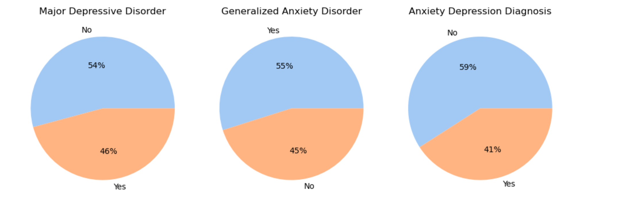
Finding1#: Almost half of participants were diagnosed with either GAD or MDD or both.

Slide 13
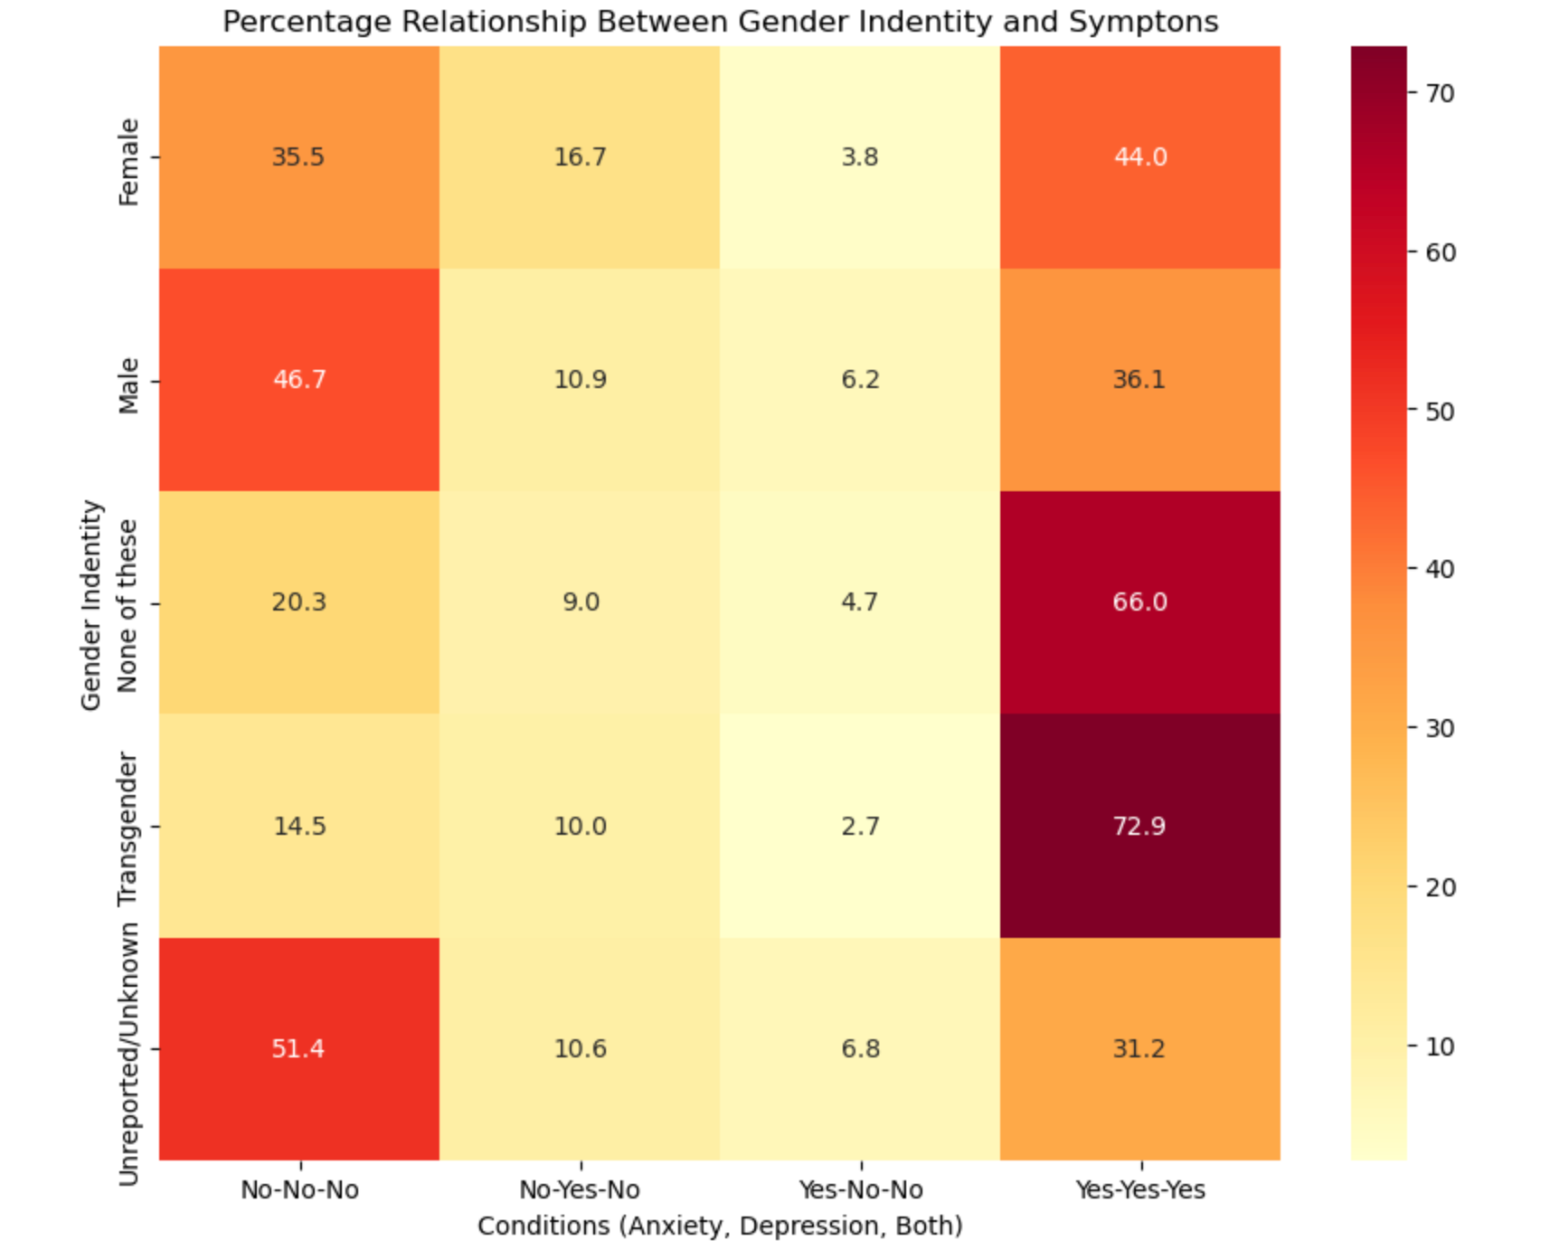
Finding2#: Gender Identity & Symptons
44% of Female are diagnosed with both Major Depressive Disorder and Generalized Anxiety Disorder
However, 46.7% of male showed neither of the mental issues.
Interestingly, transgender is a group with a very high percentage of 72.9% of being diagnosed with both Major Depressive Disorder and Generalized Anxiety Disorder

Slide 14
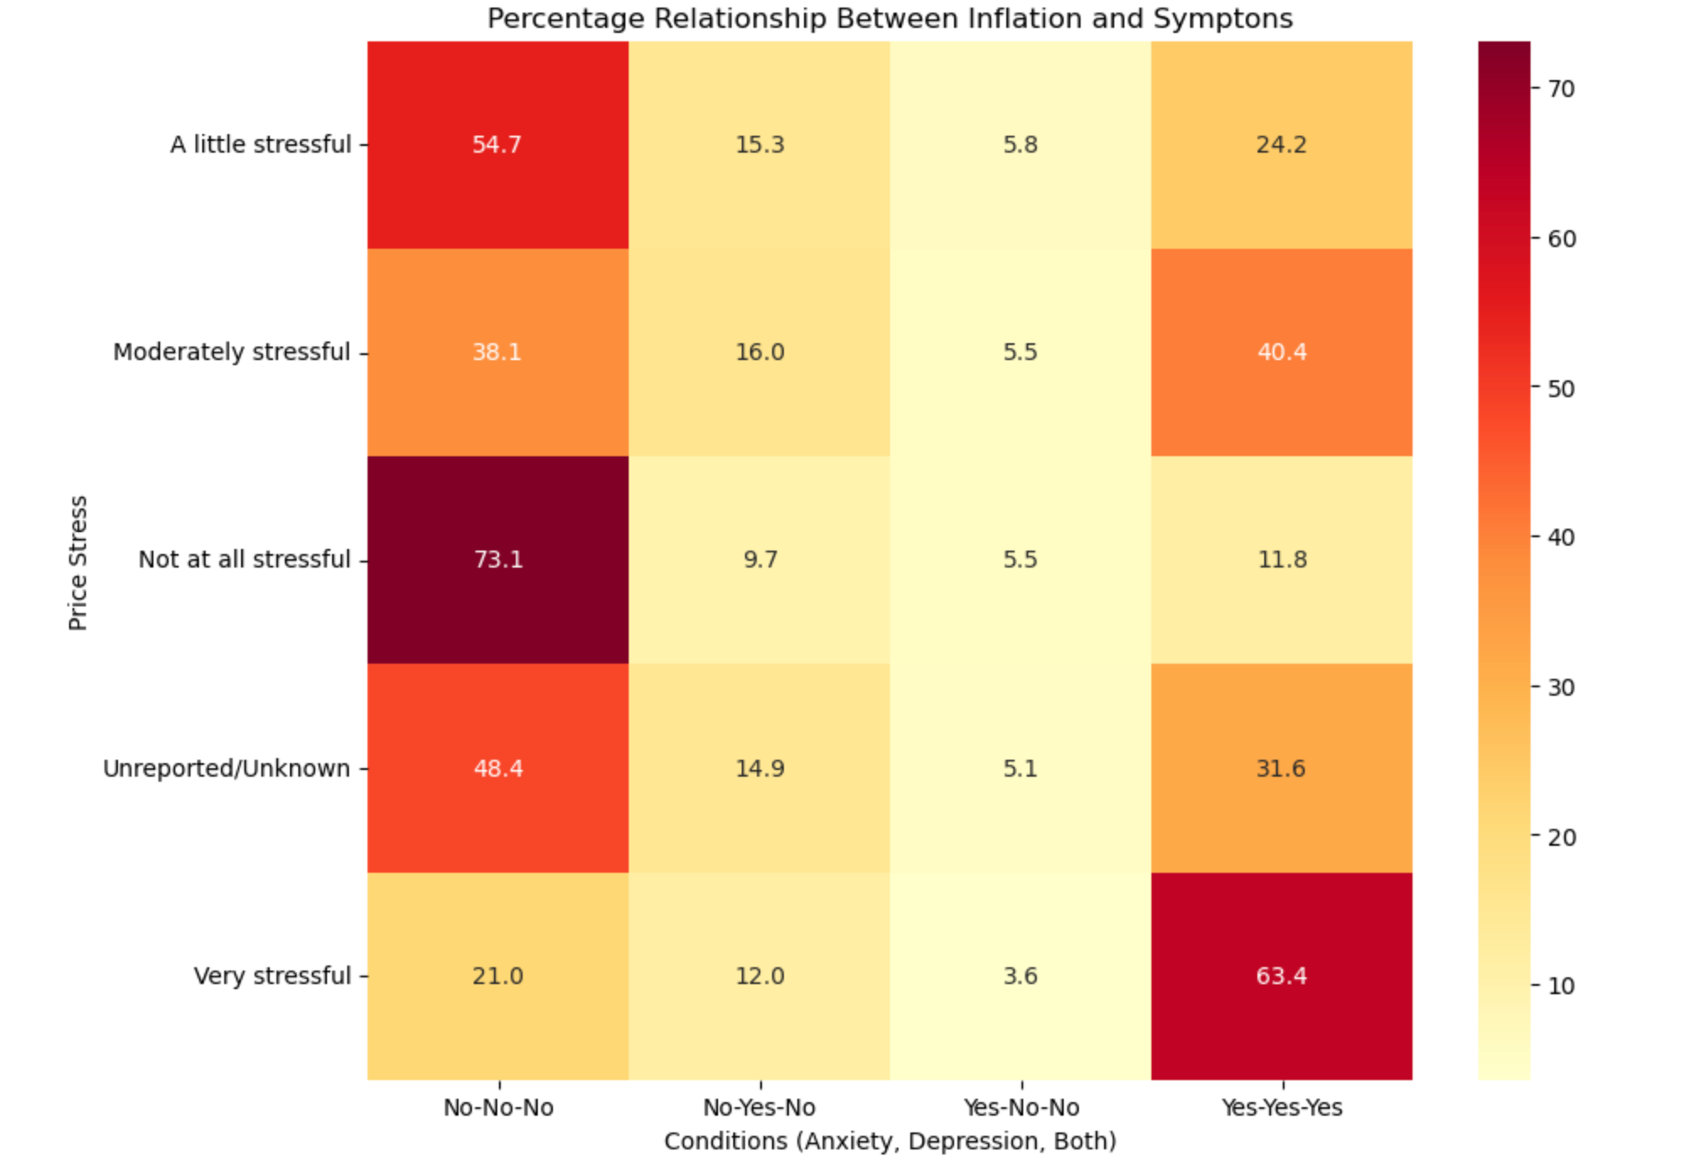
Finding3#: Price Stress & Symptons
63.4% of People who reported very stressful about price are diagnosed with both Major Depressive Disorder and Generalized Anxiety Disorder.
40.4% of People who reported moderately stressful about price are diagnosed with both Major Depressive Disorder and Generalized Anxiety Disorder.
73.1% of people who reported not at all stressful about price are diagnosed with neither of the mental issues.
54.7% of people who reported a little stressful about price are diagnosed with neither of the mental issues.

Slide 15
Many Other Interesting Findings
78.3% of People who reported job loss in the last 4 weeks, are diagnosed with either Major Depressive Disorder or Generalized Anxiety Disorder.
71.8% of People who reported medical shortage are diagnosed with either Major Depressive Disorder or Generalized Anxiety Disorder.

Slide 16
Next Action
PART 04

Slide 17
Action Plan
- Keep Exploring new columns
- Feature Engineering
- Modeling
- Modeling Evaluation and Optimization
- Documentation

Slide 18
Thank you

